Slide 1

Machine Learning Bayesian Parameter Estimation
Indian Institute of Information Technology Sri City, Chittoor

Slide 2
Today’s Agenda
Introduction to Bayesian Parameter estimation
BPE: The Class-Conditional Densities
BPE: The Parameter Distribution
Bayesian Parameter Estimation: General Theory
When do Maximum Likelihood Estimation and Bayes Parameter Estimation methods differ?
Three different error sources in classifier design
Additional Resources

Slide 3
Introduction to Bayesian estimation
Estimation of Bayesian parameters will generally be nearly identical to those obtained by maximum likelihood, there is a conceptual difference.
Whereas in maximum likelihood methods we view the true parameter vector we seek, θ, to be fixed.
In Bayesian learning we consider θ to be a random variable, and training data allows us to convert a distribution on this variable into a posterior probability density.

Slide 4
BPE: The Class-Conditional Densities
The computation of the posterior probabilities P(ω_{i}|x) lies at the heart of Bayesian classification.
Bayes’ formula allows us to compute these probabilities from the prior probabilities P(ω_{i}) and the class-conditional densities p(x|ω_{i}).
How to proceed when you don’t know these parameters?
Best we can do is to compute P(ω_{i}|x) using all of the information available.

Slide 5
BPE: The Class-Conditional Densities
If we again let D denote the set of samples, then we can emphasize the role of the samples by saying that our goal is to compute the posterior probabilities P(ω_{i}|x,D).
From these posterior probabilities we can obtain the Bayes classifier.
Given the sample D, Bayes’ formula then becomes
As this equation suggests, we can use the information provided by the training samples to help determine both the class-conditional densities and the a priori probabilities.
Assume that the true values of the a priori probabilities are known

Slide 6
BPE: The Class-Conditional Densities
Furthermore, since we are treating the supervised case, we can separate the training samples by class into c subsets D₁, ...,D_{c}, with the samples in D_{i} belonging to ω_{i}.
As we mentioned when addressing maximum likelihood methods, in most cases of interest (and in all of the cases we shall consider), the samples in D_{i} have no influence on p(x|ω_{j} ,D) if i ≠ j.
This has two simplifying consequences:
First, it allows us to work with each class separately, using only the samples in Di to determine p(x|ω_{i},D).
Second, because each class can be treated independently, we can dispense with needless class distinctions and simplify our notation.

Slide 7
BPE: The Class-Conditional Densities
Hence equation,
Can be written as,
In essence, we have c separate problems of the following form: use a set D of samples drawn independently according to the fixed but unknown probability distribution p(x) to determine p(x|D). This is the central problem of Bayesian learning.

Slide 8
BPE: The Parameter Distribution
Although the desired probability density p(x) is unknown, we assume that it has a known parametric form.
The only thing assumed unknown is the value of a parameter vector θ.
We shall express the fact that p(x) is unknown but has known parametric form by saying that the function p(x|θ) is completely known.
Any information we might have about θ prior to observing the samples is assumed to be contained in a known prior density p(θ).
Observation of the samples converts this to a posterior density p(θ|D), which, we hope, is sharply peaked about the true value of θ.

Slide 9

BPE: The Parameter Distribution
What we are trying to do now is supervised learning?
Currently our basic goal is to compute p(x|D), which is as close as we can come to obtaining the unknown p(x).
We do this by integrating the joint density p(x, θ|D) over θ. That is,
where the integration extends over the entire parameter space.
We can write p(x, θ|D) as the product p(x|θ,D)p(θ|D).
Since the selection of x and that of the training samples in D is done independently, the first factor is merely p(x|θ).

Slide 10
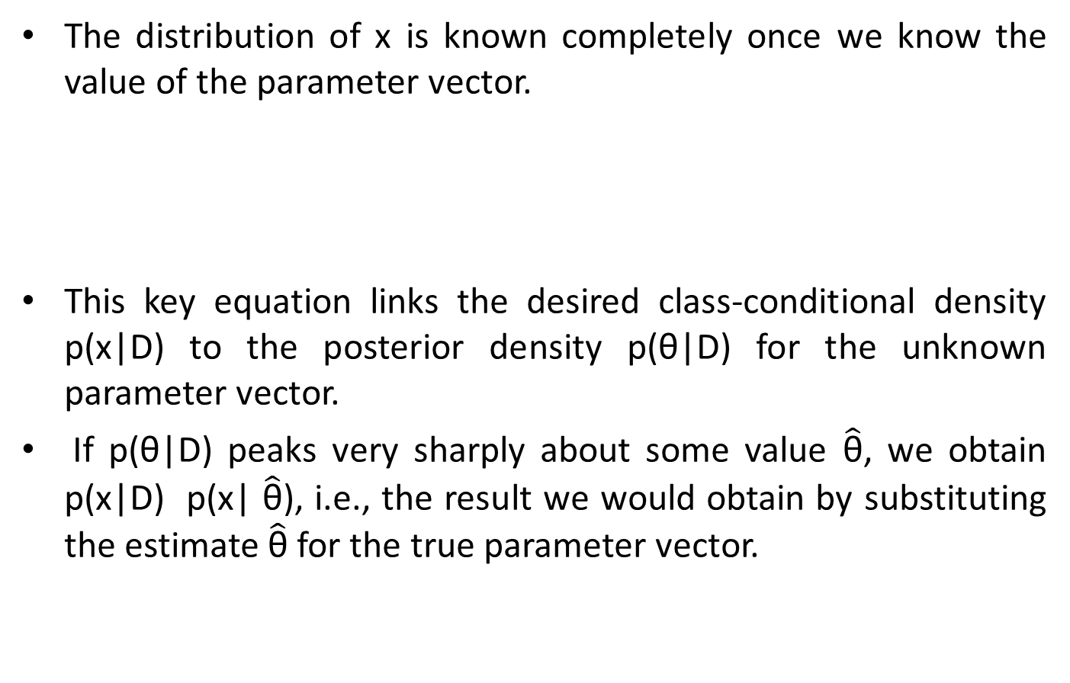
BPE: The Parameter Distribution
The distribution of x is known completely once we know the value of the parameter vector.
This key equation links the desired class-conditional density p(x|D) to the posterior density p(θ|D) for the unknown parameter vector.
If p(θ|D) peaks very sharply about some value $\hat{\text{θ}}$, we obtain p(x|D) p(x| $\hat{\text{θ}}$), i.e., the result we would obtain by substituting the estimate $\hat{\text{θ}}$ for the true parameter vector.

Slide 11

Bayesian Parameter Estimation: General Theory
The basic assumptions are summarized as follows:
The form of the density p(x|θ) is assumed to be known, but the value of the parameter vector θ is not known exactly.
Our initial knowledge about θ is assumed to be contained in a known a priori density p(θ).
The rest of our knowledge about θ is contained in a set D of n samples x1, ..., xn drawn independently according to the unknown probability density p(x).
The basic problem is to compute the posterior density p(θ|D), since from this we can use prev. eq to compute p(x|D):

Slide 12
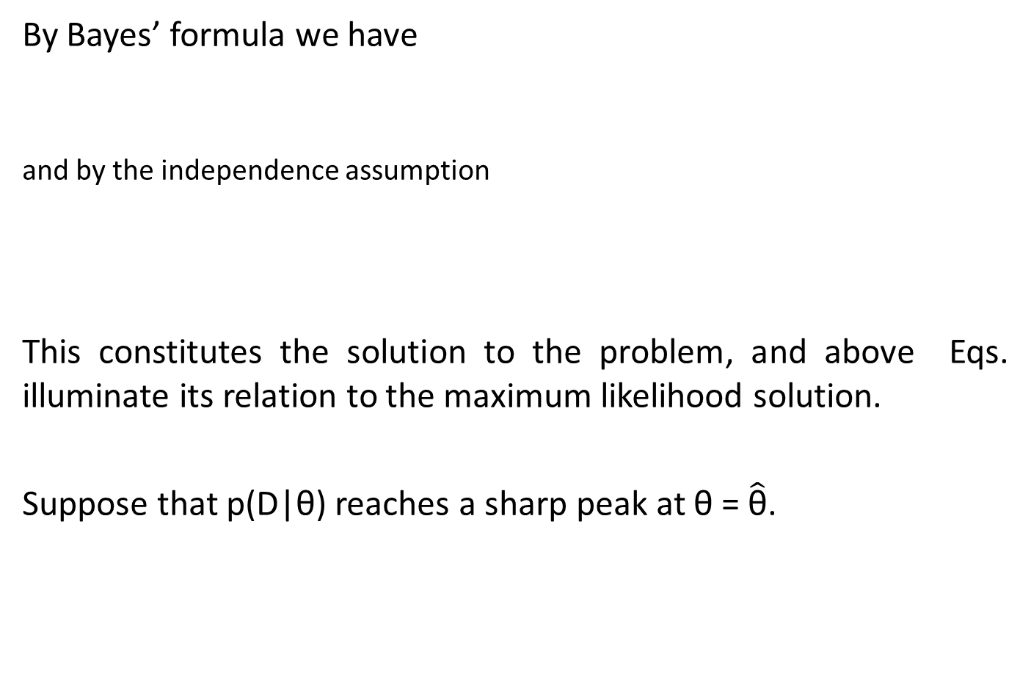
Bayesian Parameter Estimation: General Theory
By Bayes’ formula we have
and by the independence assumption
This constitutes the solution to the problem, and above Eqs. illuminate its relation to the maximum likelihood solution.
Suppose that p(D|θ) reaches a sharp peak at θ = $\hat{\text{θ}}$.

Slide 13
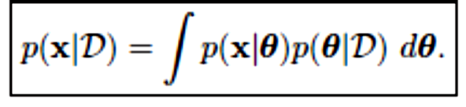
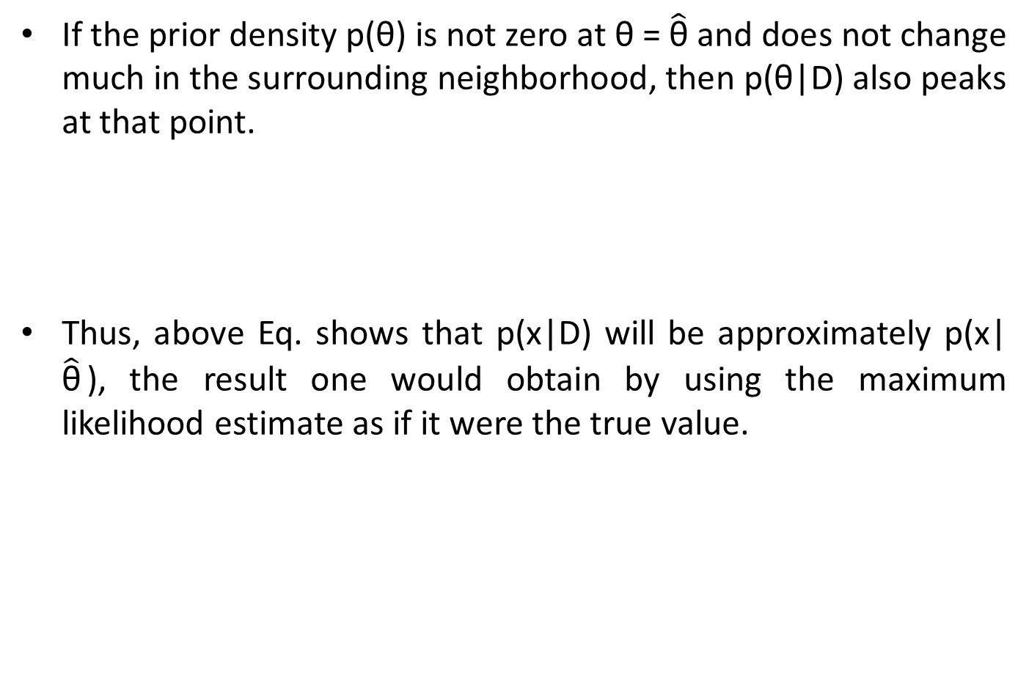
Bayesian Parameter Estimation: General Theory
If the prior density p(θ) is not zero at θ = $\hat{\text{θ}}$ and does not change much in the surrounding neighborhood, then p(θ|D) also peaks at that point.
Thus, above Eq. shows that p(x|D) will be approximately p(x| $\hat{\text{θ}}$), the result one would obtain by using the maximum likelihood estimate as if it were the true value.

Slide 14
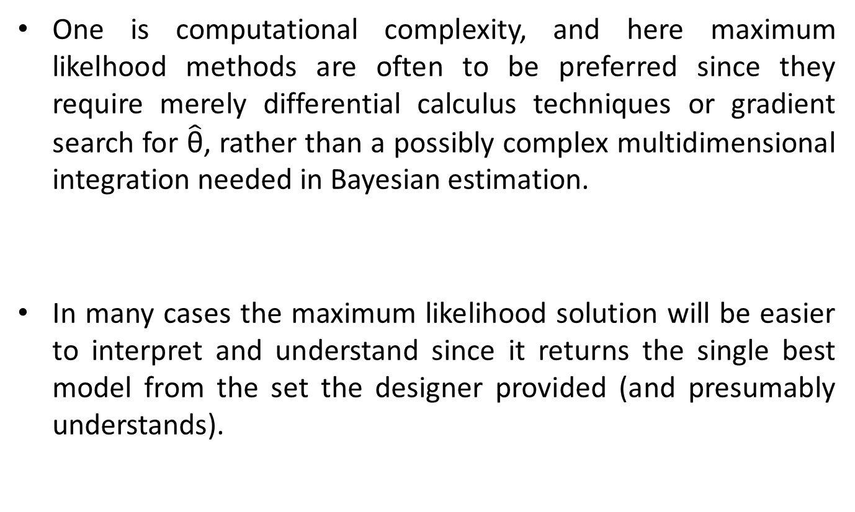
When do Maximum Likelihood Estimation and Bayes Parameter Estimation methods differ?
One is computational complexity, and here maximum likelhood methods are often to be preferred since they require merely differential calculus techniques or gradient search for $\hat{\text{θ}}$, rather than a possibly complex multidimensional integration needed in Bayesian estimation.
In many cases the maximum likelihood solution will be easier to interpret and understand since it returns the single best model from the set the designer provided (and presumably understands).

Slide 15
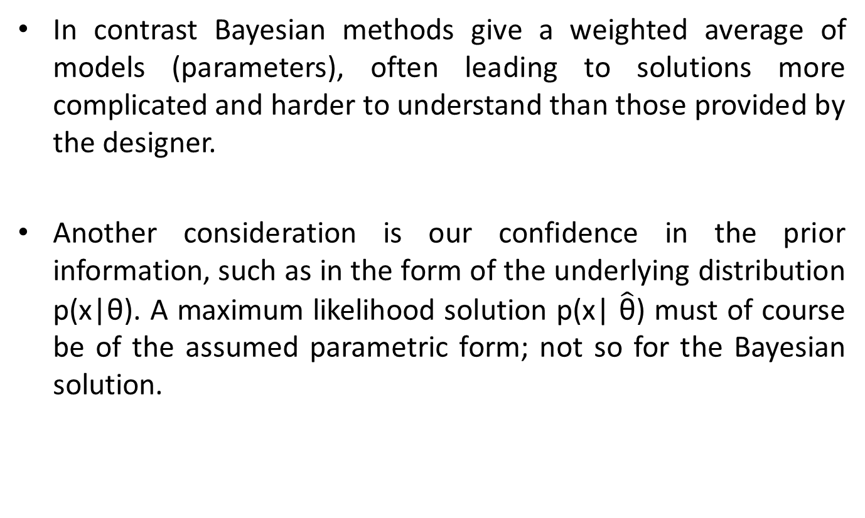
When do Maximum Likelihood Estimation and Bayes Parameter Estimation methods differ?
In contrast Bayesian methods give a weighted average of models (parameters), often leading to solutions more complicated and harder to understand than those provided by the designer.
Another consideration is our confidence in the prior information, such as in the form of the underlying distribution p(x|θ). A maximum likelihood solution p(x| $\hat{\text{θ}}$) must of course be of the assumed parametric form; not so for the Bayesian solution.

Slide 16
Three different error sources in classifier design
Bayes or indistinguisability error: the error due to overlapping densities p(x|ω_{i}) for different values of i. This error is an inherent property of the problem and can never be eliminated.
Model error: the error due to having an incorrect model. This error can only be eliminated if the designer specifies a model that includes the true model which generated the data. Designers generally choose the model based on knowledge of the problem domain rather than on the subsequent estimation method, and thus the model error in maximum likelihood and Bayes methods rarely differ.
Estimation error: the error arising from the fact that the parameters are estimated from a finite sample. This error can best be reduced by increasing the training data.

Slide 17
Additional Resources:
https://towardsdatascience.com/probability-concepts-explained-bayesian-inference-for-parameter-estimation-90e8930e5348
https://cedar.buffalo.edu/~srihari/CSE555/Chap3.Part2.pdf
https://www.projectrhea.org/rhea/index.php/Bayes_Parameter_Estimation

